Slide 1
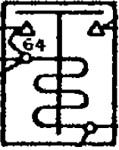
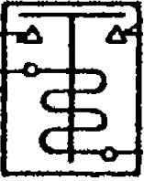

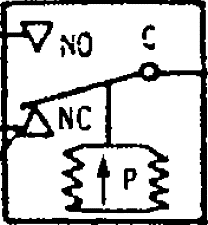
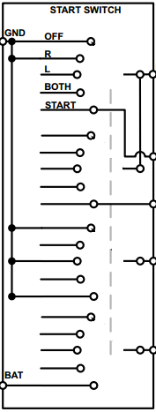
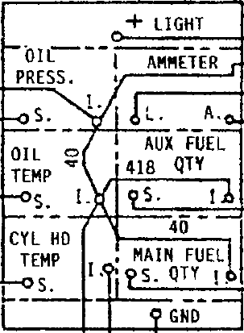
Relay de Batería
Motor de Arranque
MOTOR
Interruptor
Interruptor de Presión de Aceite
Interruptor de Arranque y Magnetos
Panel de Instrumentos

Slide 2
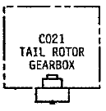



Luz de Advertencia Ambar
Detector Particulas R/C
Luz de Advertencia Roja
T.G.R.B CHIP
Interruptor para Pruebas
Relay Luz Gobernador

Slide 3
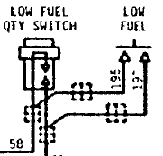
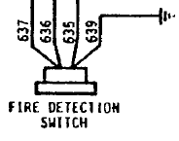
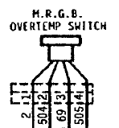
Interruptor Bajo Nivel de Combustible
Detector de Fuego
Interruptor de Temperatura M.R.G.B

Slide 4



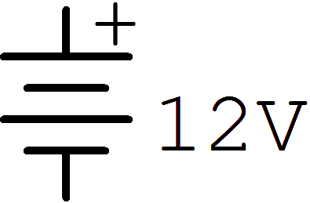


C543 CONSOLE ELECTRICAL CONNECTOR
GOV. CONTROLLER
K
CONECTOR
J
F
C1-3
C1-5
C2-5
C2-18
C2-16
C2-17
C2-10
C2-11
C2-15
C2-24
C2-7 | 163
G
TACH SENDER
H
WHITE
B
F
E
M
N
K
R
J
C
A
D
H
L
P
80(ORANGE)
80(ORANGE)
1
2
3
RED
GREEN
81(WHITE)
81(WHITE)
A
BLUE
YELLOW
82(BLUE)
82(BLUE)
BLACK
B
RED
71(+)
C
ORANGE
573
574
D
72(+)
BLUE
83
1
E
83(WHITE)+MOTOR
BROWN
89
2
BLACK
89(BLUE)
+MOTOR
71
YELLOW/WHITE
2
E
28
A SW CLUTCH
72
2
TACH
MASTER RADIO RELAY
R
BARRA DE ALIMENTACION
BARRA DE ALIMENTACION
BARRA DE ALIMENTACION
176
29
Notes:
DUAL TACOMETRO

Slide 5


Batería
TACH
Magneto Tacómetro
TACH SENDER
Sensor Tacómetro
Cable Coaxial Blindado de tres hilos
K
J
Flotador Cantidad de Combustible
F
G
H
A
Caja Control Gob.
CYL HEAD TEMP. SENDER
Sensor Temperatura
CYL HEAD TEMP. SENDER
B
C
D
2
Circuit Breaker
E

Slide 6


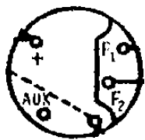
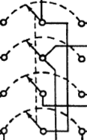
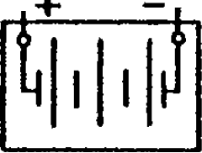
ENG. OIL PRESS. SENDER
3
Fusible 3 amp
Diodo
Block de conexiones
NC
Interruptor
Tierra
NO
2
BLACK
Alternador
GEAR-MOTOR
Motor Clutch
1
RED
Batería
SW. Clutch

Slide 7

C1-10
13
SHUNT
12
ENG. OIL PRESS. SENDER
10
INSTRUMENT CLUSTER
C1-09
506
417
2
129
AUX. FUEL QTY SENDER
13
1
C1-07
12
C1-22
416
11
59
2
MAIN FUEL QTY SENDER
BARRA DE ALIMENTACION
46
416
1
2
2
TO M.R.G.B. OVERTEMP SWITCH
129
34
52
C1-28
52
128
2
569
WARNING LTS TERM. BLOCK
C1-17
34
CYL HEAD TEMP. SENDER
GREEN
RED
11
ENG. OIL TEMP. SENDER
BLACK
C1-18
C604
CARB AIR TEMP GAUGE
Notes:
INSTRUMENTOS

Slide 8

95
C1-22
C2-30
C2-31
C2-32
C2-27
C2-35
95
TO LOW RPM WARNING UNIT
90
90
631
632
91
91
94
94
FUSE 3 AMP.
96
BLACK
28
98
2
GEAR-MOTOR
91
28
97
RED
95
138
1
TO CLOCK POWER
93
138
ENGAGE
113
CONSOLE CONNECTOR
88
CLUTCH SWITCH
91
90
97
98
95
93
DISENGAGE
TO MASTER RADIO RELAY
1 | 2 | 3 | 4 | 5 | 6
98
92
90
TO BATERY POWER
3
CLUTH WARNING LIGHT
94
2
TEST* PLUG
66
66
1355*
66
C2-28
C2-29
142
D602-1 TIME DELAY
1
67
67
98
71
28
28
91
90
97
98
1354*
TO TACH BUS
98
SPRING SW
1 | 2 | 3 | 4 | 5 | 6
SPRING SW
99
TO LANDING LIGHT SWITCH
138
NC
NC
72
C
99
C
138
9
8
7
6
ON
NO
NO
NC
OFF
5
91
3
C
112
EXTENSION LIMIT SW
95
NO
LANDING LIGHTS SWITCH
A15A
NC
139
NO
90
C
RETRACTION LIMIT SW
NO
Notes:
CIRCUITO DE TENSION DEL ACTUADOR

Slide 9
BARRA DE ALIMENTACION
AMP.
128
2
102
14
13
12
ALTERNADOR
5
SHUNT
580
22
24
19
18
SW ALTERNADOR
TERMINAL JUMPERS
507
23
198
33
199
23
1
2
3
4
5
6
7
BLUE
A780-25
BATERIA
507
ORANGE
580
18
RED
A942
ALTERNATOR CONTROL
UNIT
RELAY
BATERIA
199
YELLOW
3AMP
65
WHITE
A15A
3AMP
33
BLACK
A15A
65
30
A15A
3AMP
66
SW BATERIA
Notes:
ALTERNADOR Y REGULADOR DE VOLTAJE

Slide 10
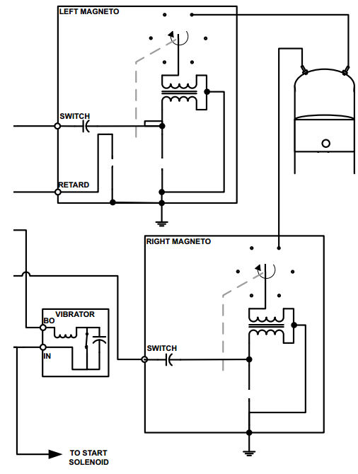

Notes:
MAGNETO

Slide 11
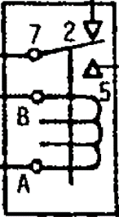

RELAY
MOTOR
LOW RPM WARNING UNIT
10
634
581
11
633
582
MOTOR
RET. SW.
BO
IN
STARTING VIBRATOR
1N4005
585
4
3
2
1
582
633
176
BATERIA
634
29
581
MASTER RELAY
RELAY
BATERIA
31
176
5
31
NO
3AMP
65
470
1
2
3
C
A15A
NC
3AMP
A15A
65
30
3AMP
66
SW BATERIA
BARRA DE ALIMENTACION
A15A
Notes:
BATERIA DE ENCENDIDO

Slide 12

IMAGENES

Slide 13

Modelos hechos

Slide 14
581
582
MOTOR
591
BATERIA TRASERA
MASTER RADIO RELAY

Slide 15
8
44
128
2

Slide 16
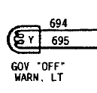
K
J
F
G
H
695
A
B
C
D
E
576
577
577
128
2
2
1
ON
576
2
OFF

Slide 17
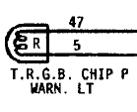
1
2
3
T.R.G.B
CHIP DETECTOR
T.G.R.B CHIP
47
5
1
2
5
128
503

Slide 18
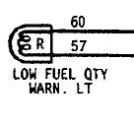
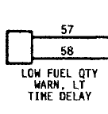
2

Slide 19

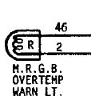
2

Slide 20
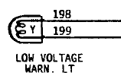
2
1
2
3
4
5
6
7
BLUE
ORANGE
RED
A942
ALTERNATOR CONTROL
UNIT
YELLOW
WHITE
BLACK

Slide 21

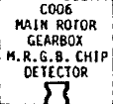

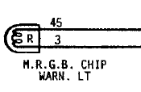
62
2
1
2

Slide 22


638
2

